Slide 1
IMPORT PROCEDURES FOR ANIMALS AND ANIMAL PRODUCTS
National Sanitary and Phytosanitary Workshop
11 March 2021
PRESENTED BY: MS NOKUTHULA CELE
DEPUTY DIRECTOR: REGULATORY SERVICE DESK
DIRECTORATE: FOOD IMPORT AND EXPORT STANDARDS

Slide 2
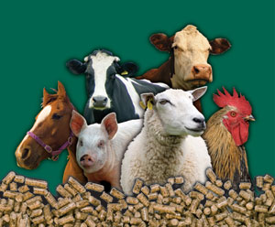
PRESENTATION OUTLINE
Introduction
Legislative Framework
General Import procedures
Application form and tariffs
Port of Entry procedures
Quarantine
Challenges and Recommendations
Contact Information

Slide 3
Importation of animals and animal products
Introduction
The Department of Agriculture, Land Reform and Rural Development is responsible for (amongst others), the management of risks associated with animals and animal products
Legislative Framework
Animal Diseases Act, 1984 (Act No. 35 of 1984)
Meat Safety Act, 2000 (Act No.40 of 2000)

Slide 4
Importation of animals and animal products
Legislative Mandate continued
The aim of the Animal Diseases Act, 1984 (Act No. 35 of 1984) is to provide for the control of animal diseases and parasites, for measures to promote animal health, and for matters connected therewith
The Animal Diseases Act may be obtained from the following link:- https://www.dalrrd.gov.za/vetweb/Legislation/Animal%20Diseases%20Act%20MAIN.htm

Slide 5
Importation of animals and animal products
Legislative Mandate continued
The aim of the Meat Safety Act, 2000 (Act No.40 of 2000) is to provide for measures to promote meat safety and the safety of animal products; to establish and maintain essential national standards in respect of abattoirs; to regulate the importation and exportation of meat; to establish meat safety schemes; and to provide for matters connected therewith.
The Meat Safety Act may be obtained from the following link:- https://www.dalrrd.gov.za/vetweb/Legislation/Meat%20safety/Act-Meat%20Safetyx.pdf

Slide 6
Importation of animals and animal products
Legislative Mandate continued
In terms of Section 6 of the Animal Diseases Act, 1984 (Act No. 35 of 1984), ‘No animal or animal product (including samples) may be imported into or moved in transit through South Africa without obtaining a veterinary import permit’
In terms of Section 13 (1)(a) the Meat Safety Act, 2000 (Act 40 of 2000), “No person may import any meat into the Republic except on the authority of a permit issued by the national executive officer”

Slide 7
Importation of animals and animal products
Legislative Mandate continued
All movement of animals and animal products carries a certain disease risk.
The process of issuing an import permit with a veterinary health certificate guarantees that a specific animal or animal product does have a certain health status complying to the importing county’s health standards as well as international health standards
The importing country sets the import requirements for risk reduction. Since they are the ones to be exposed to risk.

Slide 8
Importation of animals and animal products
Import Procedures
The applicant must arrange for the permit to be collected in person or arrange a courier service
A Veterinary Health Certificate (VHC) will accompany the Veterinary Import Permit (VIP).
The VHC needs to be completed before departure within the set time frame in English by a Veterinarian authorized thereto by the Veterinary Authority of the exporting country

Slide 9
Importation of animals and animal products
Application form and tariffs
The CORRECT application form for the importation of the specific animal or animal product must be duly completed.
A VIP should be obtained by the importer before the relevant animal or animal product is removed from the country of origin for the purpose of importing it into the Republic
The forms can be obtained from the Permit Office or on the website:- https://www.dalrrd.gov.za/Branches/Agricultural-Production-Health-Food-Safety/Animal-Health/importexport/forms
The duly completed application form together with proof of payment and other required documentation can be emailed to VetPermits@Dalrrd.gov.za

Slide 10
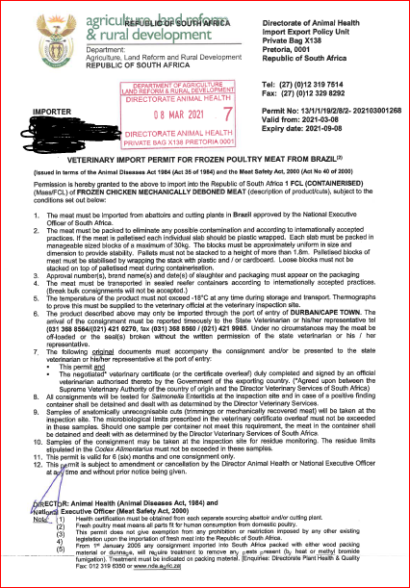
Importation of animals and animal products
Veterinary import permits are usually issued within 5 to 10 working days provided that an agreed upon Veterinary Import permit (VIP) and Veterinary Health Certificate (VHC) are in place with the exporting country / country of origin.
If there is no agreed upon VIP and VHC the process can and will take longer.

Slide 11
Importation of animals and animal products
Application form and tariffs continued
Applications is NOT lodged if the correct proof of payment is not received with the application form.
Normal post is conducted free of charge, the permit office does not offer a courier service, clients must arrange for own courier.
In cases where applying as an agent please make sure that you make the transfer/deposit in that’s person’s name or company’s name.

Slide 12
Importation of animals and animal products
Port of Entry Procedures
Original Veterinary Import Permit (VIP)
Original Veterinary Health Certificate (VHC)
Any other documentation specified e.g.: Rabies Vaccination Certificate, Blood Test Result etc…

Slide 13
In cases where quarantine of animals is required
The importer must contact the State Veterinarian at the port of entry on the following contacts
ORTIA & Quarantine Tel +27 11 393 7983 Fax +27 11 973 2828 RomonaN@dalrrd.gov.za
Durban Tel +27 31 368 8503 Fax +27 31 368 8557 SharonS@dalrrd.gov.za
CTIA & Quarantine Tel +27 21 526 3261 Fax +27 21 421 0270/1 DonniaO@Dalrrd.gov.za
The State Veterinarian will arrange the reservation for accommodation at the Quarantine Station and must complete the applicable part of the application form.
The State Vet will then forward the form to the permit office.
An Indemnity Declaration (in respect of imported animals or birds undergoing quarantine) must also be completed and attached to the application form. This Indemnity Declaration form can also be obtained from the Permit Office.

Slide 14
CHALLENGES
RECOMMENDATIONS
Incomplete applications
Unsigned applications
Incorrect payment
Incorrect company name
Incorrect info with enquiries
Incorrect email address
Delays from post office
Delayed enquiries
LATE APPLICATIONS
Incorrect applications used
Complete as per application form, ask for clarity where necessary
Please sign and date application
Enquire and ensure correct payment is made and sent with application form
Company name cannot be amended, Use correct name or pay & apply for a new permit
Please follow up with correct details
Please ensure email address on application is valid
Use a Courier company
Follow up
APPLY PRIOR TO IMPORTATION
Use the latest application form

Slide 15
Banking details-VETERINARY IMPORT PERMITS
Name of Bank: STANDARD BANK OF SOUTH AFRICA
Account Holder: NATIONAL DEPARTMENT OF AGRICULTURE
Account Number: 011219556
Branch Code: 010845
Branch Name: ARCADIA
Reference: Unique reference number not more than 10 digits and not to be repeated.
Payments can also be made at the department’s cashiers

Slide 16
CONTACT Information
NAME | DESIGNATION | CONTACT | E-MAIL
Ms. Amanda Steyn | Assistant Director- Veterinary Import Permits | 012 319 7476 | VetPermits@Dalrrd.gov.za
Ms. Nokuthula Cele | Deputy Director- Regulatory Service Desk | 012 319 6313 060 973 4078 | ThuleN@Dalrrd.gov.za
Thank you

